Slide 1
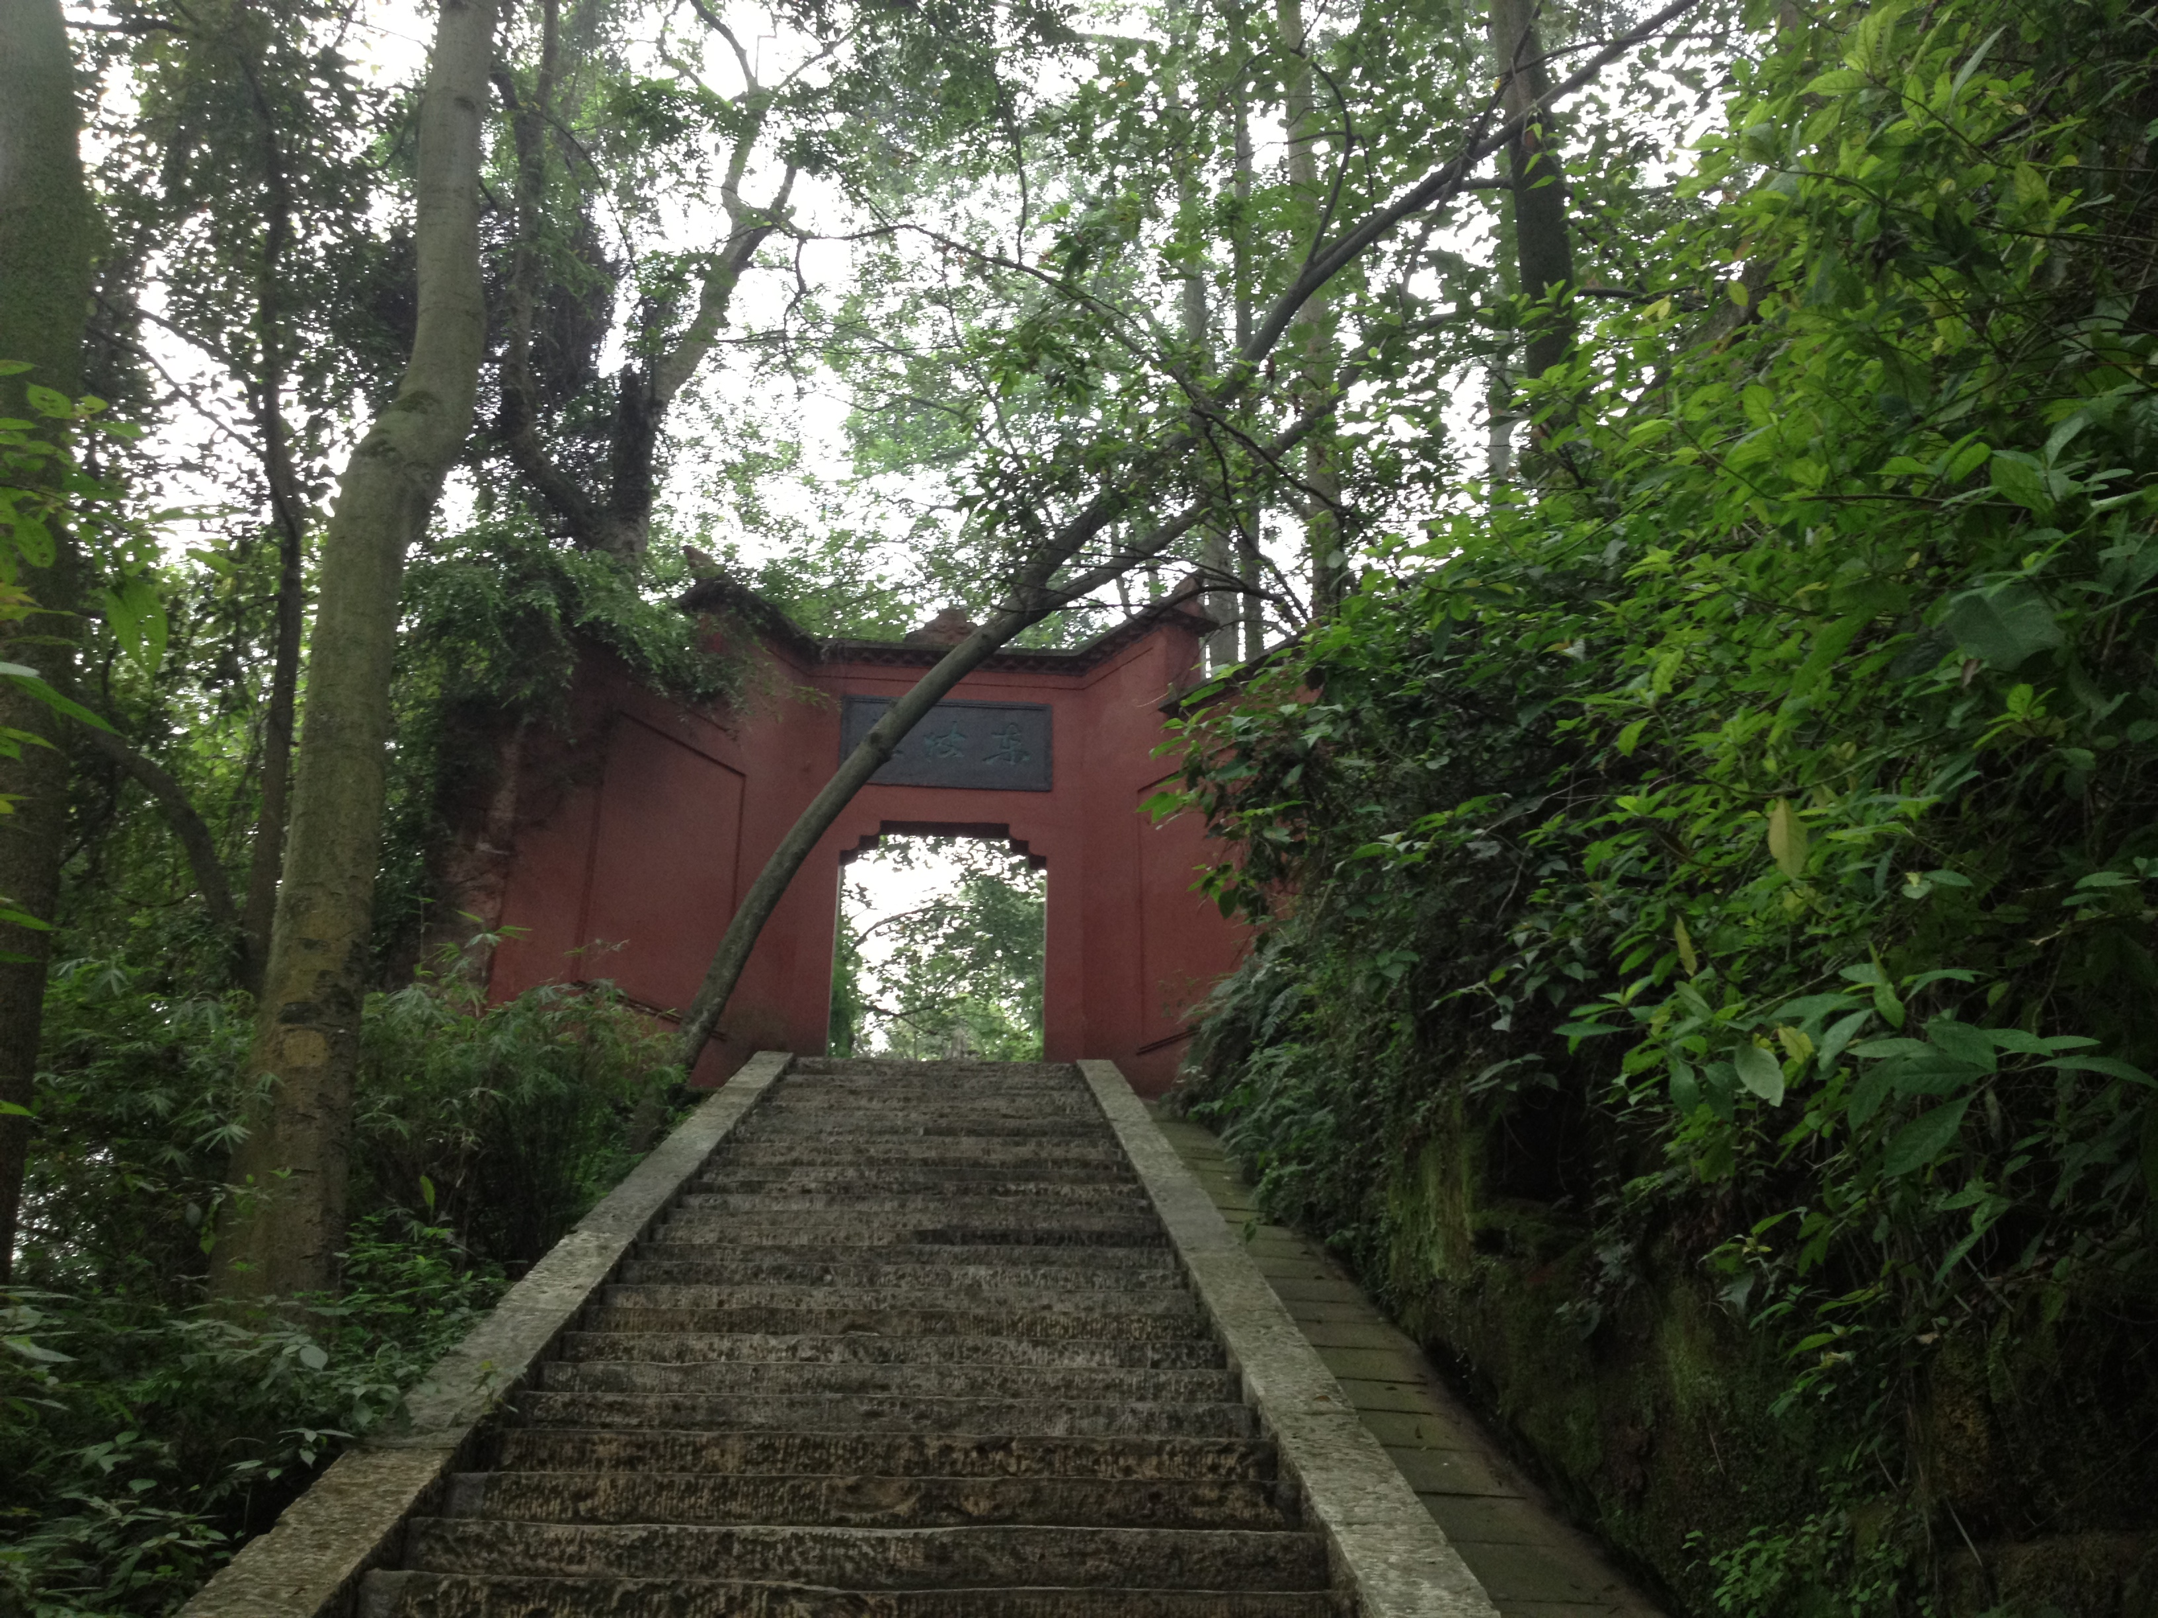
Mining and ‘Sustainable’ Development in Armenia
Saleem H. Ali
E: s.ali3@uq.edu.au
Web: csrm.uq.edu.au
Twitter: @resourcerules and @saleem_ali

Slide 2
Elemental Reality

Slide 3
What role has mining played in economic growth and social development internationally?

Slide 4
What were the key factors in making mining (and extractive industries as a whole) a positive contributor to economic growth AND social development?
Key linkage between economic growth and social development is innovation – how well can the growth creatively lift population out of poverty and sustain that quality of life
Armenia’s high literacy (and skill-set profile) gives it a competitive edge in making that prospect far more likely to be expeditious (research of the late Alice Amsden in Korea)
Inequality will need to be carefully monitored and social policies calibrated accordingly (Thailand’s woes)

Slide 5
What are the models of success and failure countries like Armenia can learn from?
Consider range of economic development paths and cash-flow generation potential: Armenia’s geopolitical limitations (landlocked, tenuous relations with neighbours, slow population growth but high youth unemployment)
Homogeniety of population helps with national-level resource allocation model (similar to Botswana) – unlike Nigeria or
Sovereign wealth funds accumulation versus disbursement must be undertaken with national consensus: Collier critique of funds when immediate development needed (in Armenia more than 1.3 of population is below UN poverty levels)

Slide 6
Multiplier effects and employment benefits
Consider the existing livelihood (labour force occupation) profile first – in Armenia’s case, agriculture agriculture: 44.2%; industry: 16.8%; services: 39% (CIA Factbook estimates)
17% of land area is considered « arable »
Direct employment wage differentials – local versus foreign workers income scale: eg. indigenous employment versus migration
Social mobility of work-force and skill-set transferability
Vertical integration prospects following – Armenia has some positive examples of this in partnership with Russia and Germany

Slide 7
Corporate Performance and Accountability
Range of models with state-owned and private multinational entities can be considered (Debswana, MMG, Rio Tinto, Xstrata Junior companies frequented at PDAC – leadership matters most at corporate level)
Industry initiatives such as ICMM as well as willingness to engage should be considered but detailed report analysis is essential by civil society who are constructively engaged
“Social License” is dynamic and not a one-time permit nor is it simply operationalized with an “agreement” – needs constant monitoring and adaptability
Pace of mining – price, poverty alleviation and pollution
Independent scientific scrutiny must remain paramount

Slide 8
Reluctance to Reveal: Example of Mazars Study
Over 500 listed mining corporations were contacted either by email and/or at the INDABA conference in Cape Town during February 2012.
62 responses came from businesses listed on the London, Australian, Toronto and Johannesburg stock exchanges:
10 respondents are listed on the London Stock Exchange (FTSE)
24 respondents are listed on the Australian Stock Exchange (ASX)
28 on the Toronto Stock Exchange (TSX) of which six were dual listed
8 are listed on the Johannesburg Stock Exchange (JSE) of which 6 were dual listed

Slide 9
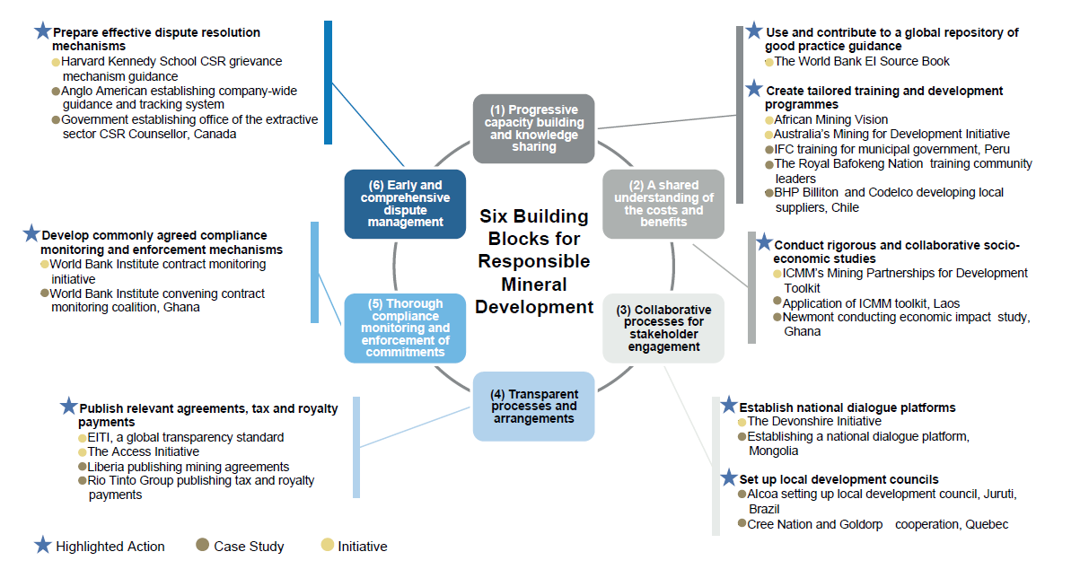

Slide 10
Coda
We cannot retreat from the big issues
“Images of pleasure and pain; fear and joy; love and hate assault us from all angles. The world around us is full of raucous chatter and noise. Try to listen to your ‘inner ear’ … in order to survive and thrive, you will have to be lifelong students….. Your reputation must not be for sale and must not be mortgaged as down payment on your ambitions…. ”
Vartan Gregorian, commencement address at Stanford University, 2006

