Slide 1
The Mining Sector, Ecosystem Services & Poverty Alleviation in Armenia
Mining & Social-Economic Policy: Armenia’s Choices. 30 November 2012, American University of Armenia
Dr Camille Bann

Slide 2
The UNDP-UNEP Poverty and Environment Initiative Project – Overall objective
To strengthen the knowledge base & capacity at the national, provincial and local levels in ecosystem valuation
Independent expertise in ecosystem valuation in order to provide scientific based evidence to stakeholders & decision makers

Slide 3
Uses of Economic Analysis of Ecosystem Services
Raise awareness
Improve decision making (policies, planning, projects)
Requires understanding, measuring and quantifying the trade-offs
Facilitate effective management including sustainable financing options
Valuation underpins the design of ‘capture mechanism’ such as PES

Slide 4
Key questions to be addressed through study
How do ecosystem services in Armenia support economic growth, employment and prosperity?
What risks / costs are associated with their damage / loss?
What are the links between ecosystem services and poverty alleviation?

Slide 5
Potential ecosystem services
ES Type | Service | Benefit / outcome
Provisioning Services | Food | Wild meats, fruits, freshwater fish and seafood harvested for commercial and subsistence purposes.
 | Wood | Timber, fuelwood and fibre
 | Water | Public water supply, water for industrial and agricultural usage
 | Natural medicines and biochemicals | Natural medicines
 | Source of energy (fuel etc) | Energy provision e.g., hydropower
Regulating Services | Regulation of GHGs | Carbon sequestration
 | Micro-climate stabilization | Air quality
 | Water regulation (storage and retention) | Flood and storm protection
 | Waste processing | Detoxification of water and sediment / waste
 | Nutrient retention | Improved water quality
Cultural Services | Spiritual, religious, cultural heritage | Use of environment in books, film, painting, folklore, national symbols, architecture, advertising
 | Educational | A ‘natural field laboratory’ for understanding biological processes
 | Recreation and ecotourism | Bird watching, hiking, canoeing
 | Landscape and amenity | Property price premiums due to views
 | Biodiversity non-use | Enhanced wellbeing associated for example with bequest or altruistic motivations

Slide 6
Draft Scenarios for Social Cost Benefit Analysis of Mining Options
Scenario | Description
Mining (BAU) | Analysis based on production quantities and mining practices proposed by company
Best practice mining | Analysis based on best practices and restoration of damage to ecosystems and equitable distribution of benefits from mining
Alternative to Mining | Development of local communities enterprise, based on NTFPs and ecotourism. Other?

Slide 7
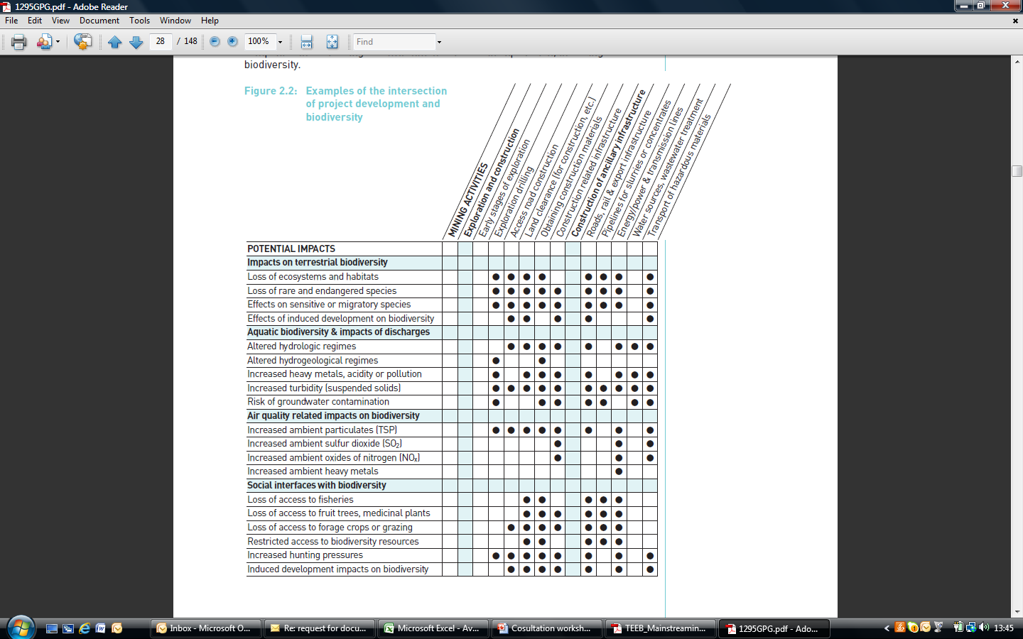
Potential Impacts of Mining (International Council on Mining & Metals, 2006 Good Practice Guidance for Mining and Biodiversity )

Slide 8
Monetising impacts
Impact on ecosystem service
∆ in ecosystem service provision
∆ in human wellbeing
↓
∆ in value

Slide 9
Distributional Analysis
Who wins, who loses?
Local Community, Government, Mining Company
What does it mean for poverty alleviation?

Slide 10
Compensation
‘No Net Loss’ / ‘Net Positive Impact’ - Rio Tinto
Involves offsetting the residual damage
Requires impacts to be quantified / monetized
Markets for ecosystem services – Wetland Mitigation Banking in the USA

Slide 11
Challenges & Opportunities
Challenges
New area for Armenia
Data
Opportunities
Framework law on environmental protection being drafted
Best practice principles and tool for assessing future mining investments

Slide 12
Thank you
Camille.bann@envecconsulting.com

